Slide 1
FITNESS-RELATED COACHING AND DIET PLANNING MOBILE APPLICATION USING IMAGE PROCESSING AND MACHINE LEARNING
FIT-GENIUS
R24-122

Slide 2


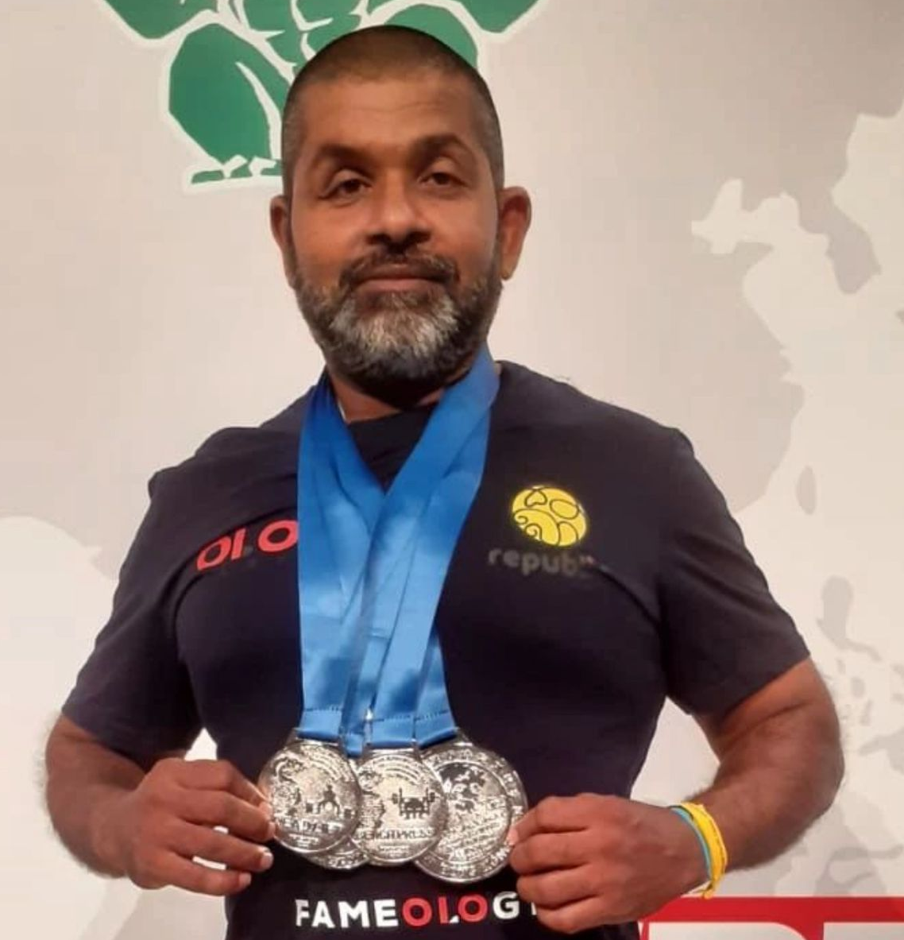


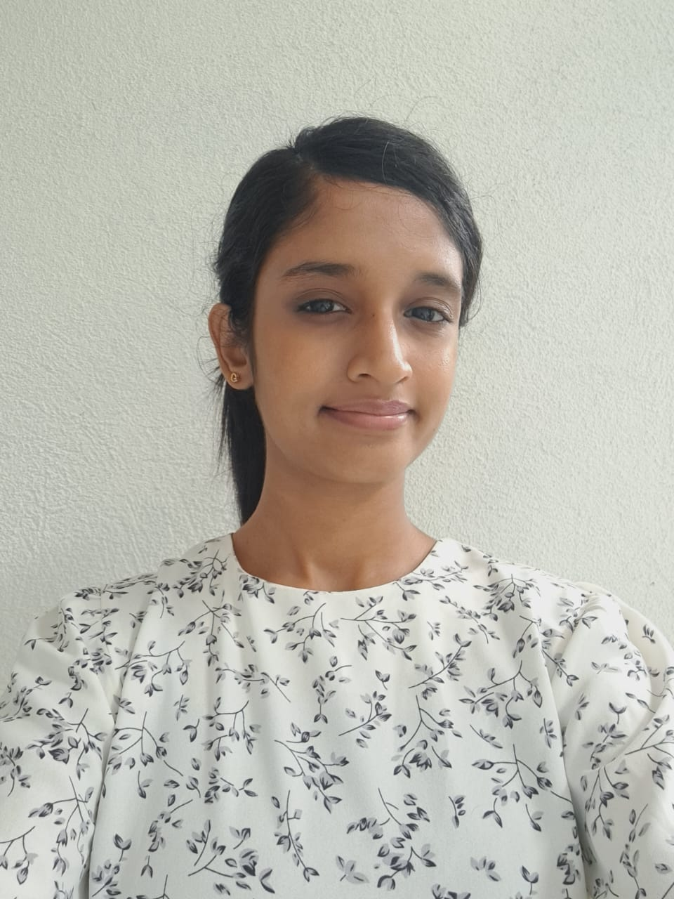

MEET OUR TEAM
Ms. Jenny Krishara
Mr. Chandana Thilakarathne
Prof. Koliya Pulasinghe
CO-SUPERVISOR
SUPERVISOR
EXTERNAL-SUPERVISOR
Ilukpitiya I.M.D.J.R.B
IT21011016
Herath H.M.R.B IT21002106
Rajakaruna R.H.M.S.A IT21114144
Herath M.H.S.M
IT21114144

Slide 3

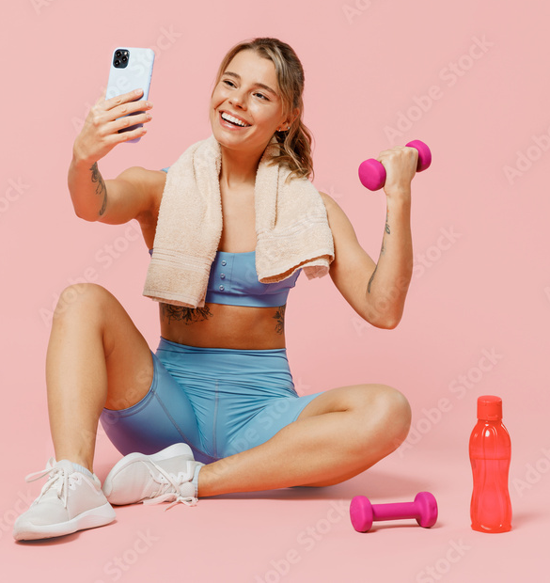
INTRODUCTION
Being physically fit is an essential part of health and wellness.
Modern life is busy; going to the gym is both hard and costly.
Personal trainers also tend to be unaffordable to many people.
Exercise alone won't achieve health goals; a good diet is crucial too.
Customized diet and exercise plans help individual's make the maximize their progress

Slide 4
GANTT CHART

Slide 5
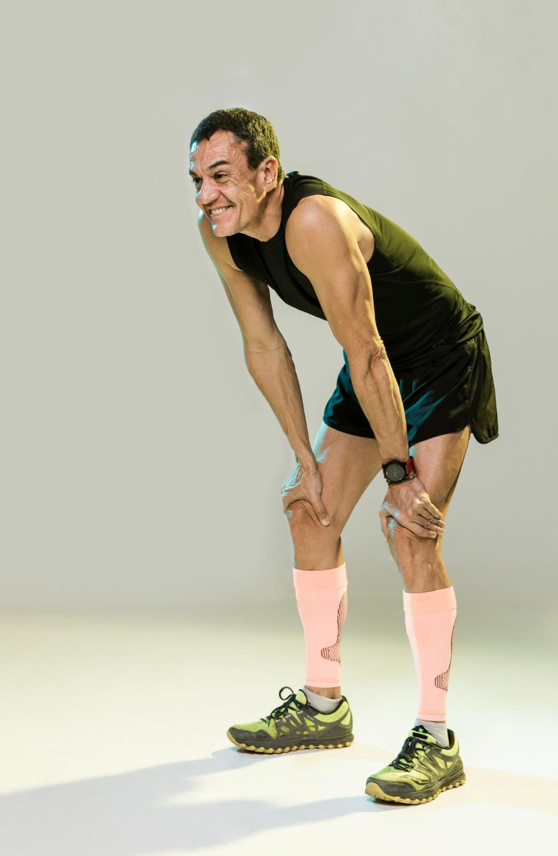





RESEARCH PROBLEM
​
Busy lives make healthy living hard; generic apps and expensive trainers lack personalization
The current apps lack customization, providing only general suggestions.
limited feedback hinders progress, leading to health issues and injuries.
This emphasizes the need for a system offering personalized health advice.

Slide 6
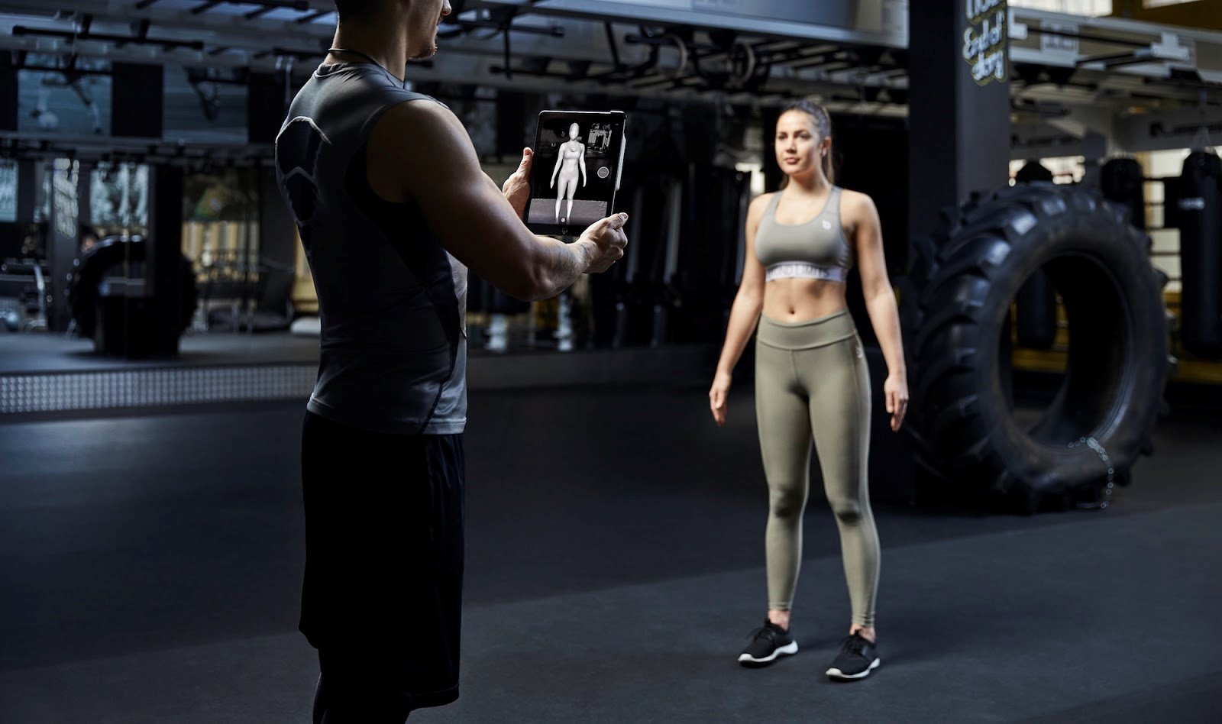
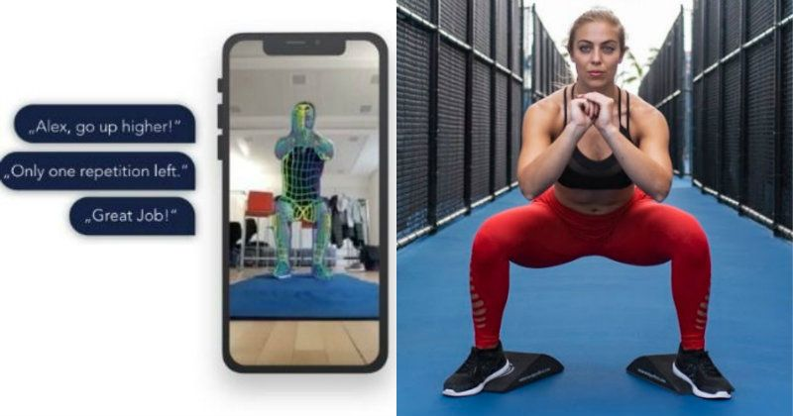



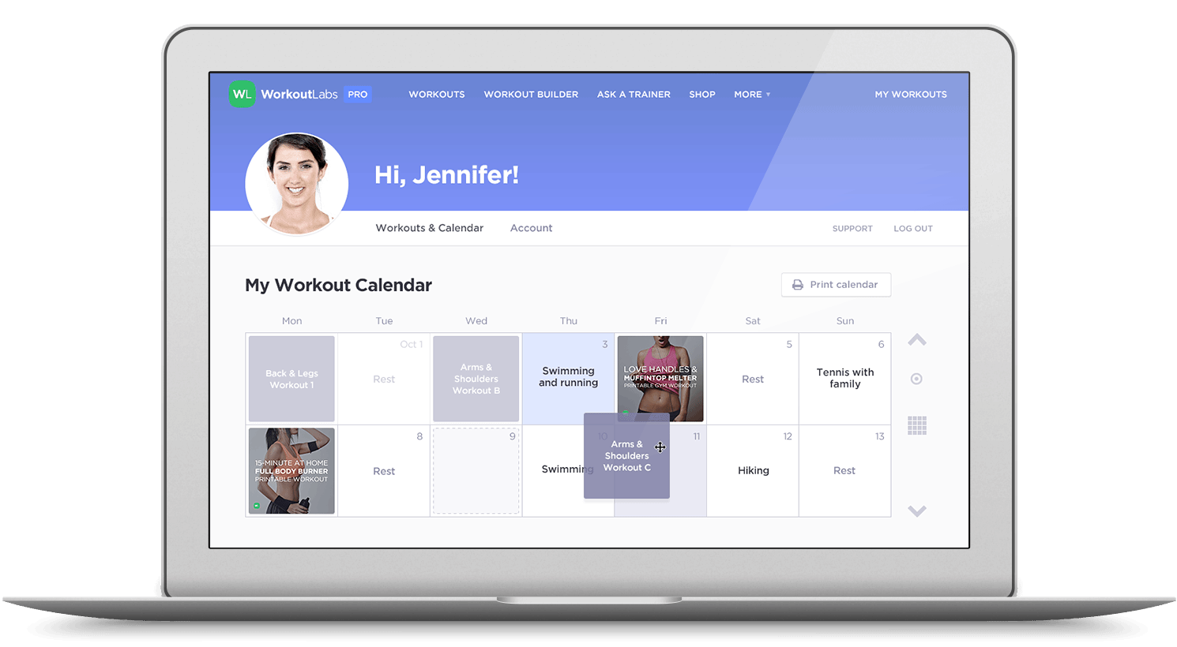


OBJECTIVES
The user needs to upload their upper-body image to analyze and identify their body type through Image Processing.​
Exercise Movement Tracking System with Real-Time Feedback​
Provide nutritional advice that is specific to everyone based on their responds.​
​
Create personalized workout plans by analyzing user responses and body analysis.​

Slide 7
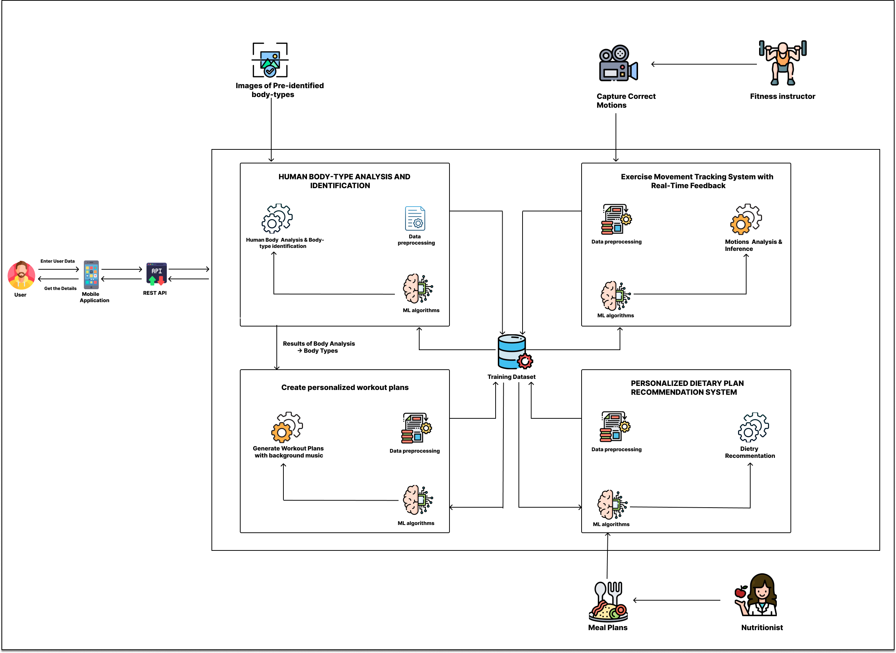
OVERALL SYSTEM DIAGRAM

Slide 8
IT21011016 | Ilukpitiya I.M.D.J.R.B
Specialization – Information Technology
IT21011016 | Ilukpitiya I.M.D.J.R.B | R24-122

Slide 9
01
HUMAN BODY-TYPE ANALYSIS AND IDENTIFICATION USING IMAGE PROCESSING AND MACHINE LEARNING TECHNIQUES.​
COMPONENT
IT21011016 | Ilukpitiya I.M.D.J.R.B | R24-122

Slide 10
BACKGROUND
What is body-type identification ?​
This is the process of categorizing the users into specific body types based on the physical characteristics of their body.​
We can categorize them into following three primary body types.
Ectomorph​
Mesomorph​
Endomorph​
So, we​
Produce a system that uses image Processing and Machine learning technologies that not only to correctly identifies the client's body type but also makes it easy to reach the fitness goals.​
IT21011016 | Ilukpitiya I.M.D.J.R.B | R24-122

Slide 11
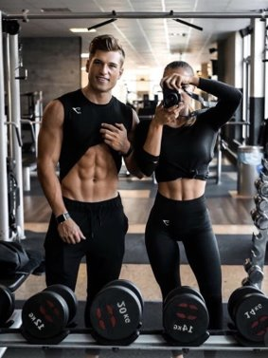
Why We Address?
Identification of body types can help to customize their nutrition and workout plans to suit their unique needs.​
Need knowledge of the body type to personalization of the workout and nutrition plan.​
There may be correlation between specific body types and higher risk of specific medical diseases. So the body analysis helps to prevent it from fitness planning.​
IT21011016 | Ilukpitiya I.M.D.J.R.B | R24-122

Slide 12
LITERATURE REVIEW
[1] G. Farina, F. Spataro, A. De Lorenzo, and H. Lukaski, “A Smartphone Application for Personal Assessments of Body Composition and Phenotyping,” Sensors, vol. 16, no. 12, p. 2163, Dec. 2016, doi: https://doi.org/10.3390/s16122163.​
​
‌[2] S. Choudhary et al., “Development and validation of an accurate smartphone application for measuring waist-to-hip circumference ratio,” npj Digital Medicine, vol. 6, no. 1, pp. 1–10, Sep. 2023, doi: https://doi.org/10.1038/s41746-023-00909-5.​
​
[3] T. Tóth, M. Michalíková, L. Bednarčíková, J. Živčák, and P. Kneppo, “Somatotypes in Sport,” Acta Mechanica et Automatica, vol. 8, no. 1, pp. 27–32, Mar. 2014, doi: https://doi.org/10.2478/ama-2014-0005.​
‌[4] L. Soileau et al., “Automated anthropometric phenotyping with novel Kinect-based three-dimensional imaging method: comparison with a reference laser imaging system,” vol. 70, no. 4, pp. 475–481, Sep. 2015, doi: https://doi.org/10.1038/ejcn.2015.132.​
IT21011016 | Ilukpitiya I.M.D.J.R.B | R24-122

Slide 13


RESEARCH GAP
 | Research A [1] | Research B [2] | Research C [3] | Proposed solution
Waist-to-hip ratio (WHR) calculation
Recommend body goal for identified body type
Considers body types (SOMATOTYPES)
Image processing
Mobile Application
IT21011016 | Ilukpitiya I.M.D.J.R.B | R24-122

Slide 14
Specific Objective
Sub Objective
Develop a system to analyze the user's body and identify the body type using image processing technology and suggest the most suitable body transformation. ​
Identifying characteristics of each body-types.​
​Efficient body type identification​
​Accurate body analysis​
​
IT21011016 | Ilukpitiya I.M.D.J.R.B | R24-122

Slide 15
SYSTEM DIAGRAM
IT21011016 | Ilukpitiya I.M.D.J.R.B | R24-122

Slide 16





TECHNOLOGIES
Flutter
python
Firebase
OpenCV
TensorFlow Lite
IT21011016 | Ilukpitiya I.M.D.J.R.B | R24-122

Slide 17

REQUIREMENTS
Non-Functional
Requirements
Software
Requirements
Functional Requirements
Python
Body Analysis and Body-Type Identification​
Performance
Jupyter Notebook
User Interaction and Engagement​
Accuracy
Flutter
Visual Studio Code
Real-Time Feedback and Guidance
Compatibility
Personal
Requirements
Reliability
Resources and To Create Dataset
Online Resources
IT21011016 | Ilukpitiya I.M.D.J.R.B | R24-122

Slide 18
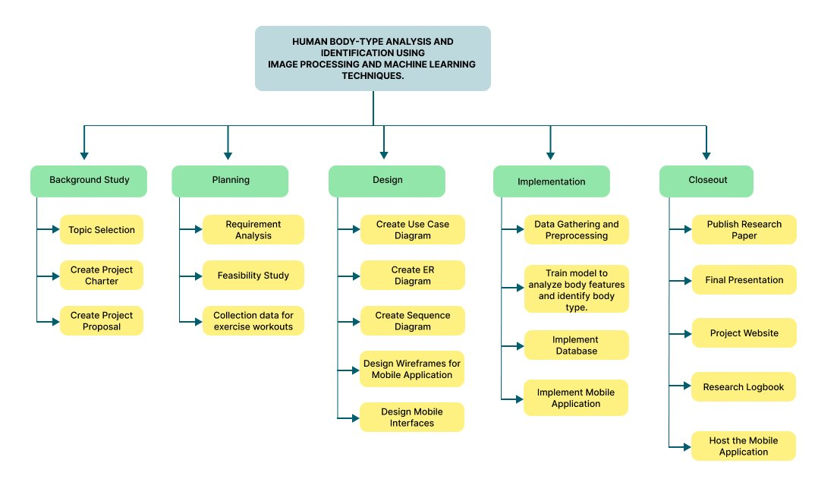
WORK BREAKDOWN STRUCTURE
IT21011016 | Ilukpitiya I.M.D.J.R.B | R24-122

Slide 19
IT21002106​ | Herath H.M.R.B
Specialization – Information Technology
IT21002106​ | Herath H.M.R.B | R24-122

Slide 20
02
Exercise Movement Tracking System with Real-Time Feedback​
COMPONENT
IT21002106​ | Herath H.M.R.B | R24-122

Slide 21
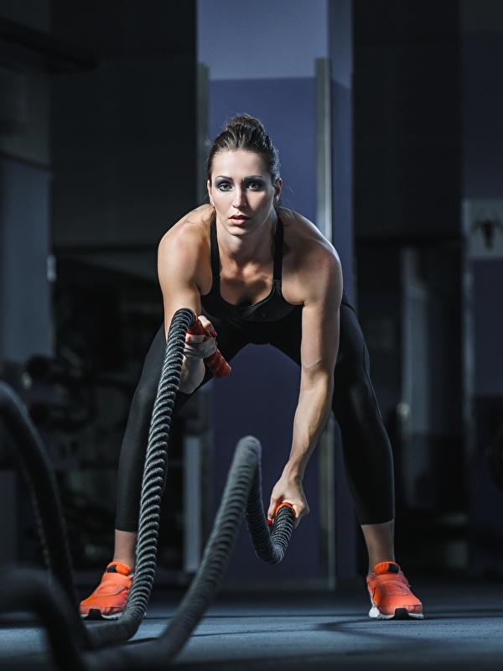
BACKGROUND
How crucial are proper exercise movements and poses for achieving fitness goals?​
Developing the effectiveness and precision of fitness training by integrating cutting-edge technologies into the workout experience. By addressing, ​
Tracking exercise movements during workouts.
Providing real-time feedback.
IT21002106​ | Herath H.M.R.B | R24-122

Slide 22
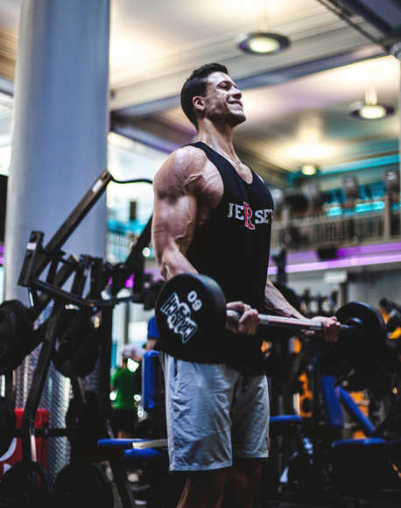
Why We Address?
Incorrect exercise poses can lead to ineffective workouts or, in some cases, increase the risk of injury.
Coaches may struggle to correct users' form and poses when evaluating recorded workouts.
How can Digital system track real time poses and movements during the exercise?
IT21002106​ | Herath H.M.R.B | R24-122

Slide 23
LITERATURE REVIEW
‌[1] M. Kranz et al., “The mobile fitness coach: Towards individualized skill assessment using personalized mobile devices,” Pervasive and Mobile Computing, vol. 9, no. 2, pp. 203–215, Apr. 2013, doi: https://doi.org/10.1016/j.pmcj.2012.06.002
[2] A. Farrokhi, R. Farahbakhsh, J. Rezazadeh, and R. Minerva, “Application of Internet of Things and artificial intelligence for smart fitness: A survey,” Computer Networks, vol. 189, no. 189, Apr. 2021, doi: https://doi.org/10.1016/j.comnet.2021.107859.
[3] S. Sun, T. Peng, H. Huang, Y. Wang, X. Zhang, and Y. Zhou, “IoT Motion Tracking System for Workout Performance Evaluation: A Case Study on Dumbbell,” IEEE Transactions on Consumer Electronics, pp. 1–1, Jan. 2023, doi: https://doi.org/10.1109/tce.2023.3320183.
[4] “Why Is Proper Workout Form Important?,” OSR Physical Therapy, May 11, 2018. https://www.osrpt.com/2018/05/proper-workout-form-important/
IT21002106​ | Herath H.M.R.B | R24-122

Slide 24
RESEARCH GAP
 | Research A [1] | Research B [2] | Research C [3] | Proposed solution
Identify incorrect movements using video processing
Real-time Feedback
Guide to the avatar of a fitness trainer and Display exercise-related data
Technology using GRNN
Mobile Application
IT21002106​ | Herath H.M.R.B | R24-122

Slide 25
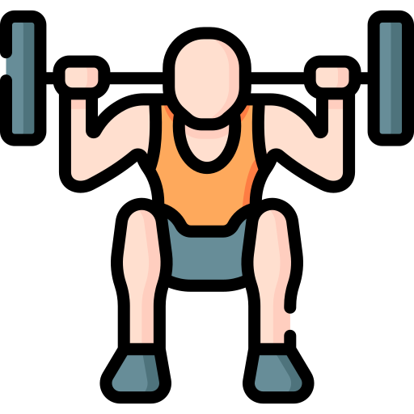
Specific Objective
Sub Objective
Implement computer vision and machine learning to provide real-time feedback for correcting exercise poses during workouts.
Data Collection and Preprocessing
Develop the algorithms to real-time Exercise Movement Tracking
Optimized real-time Feedback Integration and Enhanced User Experience
​
IT21002106​ | Herath H.M.R.B | R24-122

Slide 26
SYSTEM DIAGRAM
IT21002106​ | Herath H.M.R.B | R24-122

Slide 27
TECHNOLOGIES
Flutter
python
Firebase
OpenCV
TensorFlow Lite
IT21002106​ | Herath H.M.R.B | R24-122

Slide 28
REQUIREMENTS
Functional Requirements
Non-Functional
Requirements
Software
Requirements
Python
Real-time Exercise Movement Tracking
Performance
Jupyter Notebook
Accuracy
Flutter
Optimized Real-time Feedback Integration
Visual Studio Code
Compatibility
Personal
Requirements
User-friendly interfaces for seamless interaction
Reliability
Resources and To Create Dataset,
Chandana Thilakarathne (National powerlifter)
Zimantra Leisure Center in Battaramulla
IT21002106​ | Herath H.M.R.B | R24-122

Slide 29
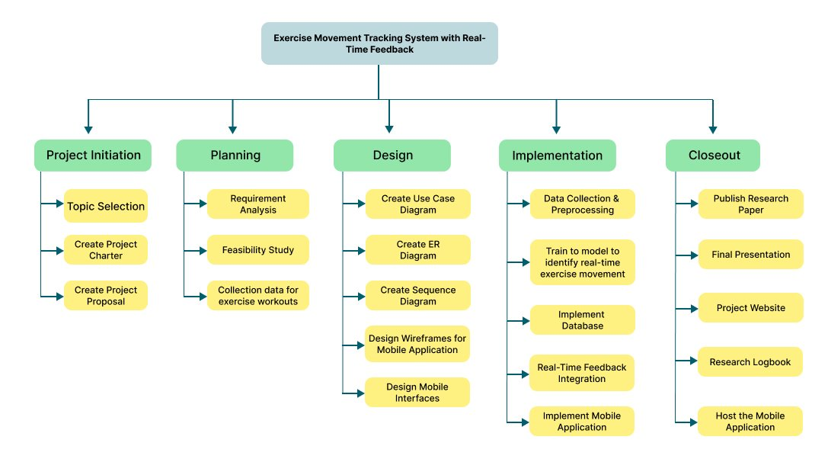
WORK BREAKDOWN STRUCTURE
IT21002106​ | Herath H.M.R.B | R24-122

Slide 30
IT21128936 | Rajakaruna R.H.M.S.A
Specialization – Information Technology
IT21128936 | Rajakaruna R.H.M.S.A | R24-122

Slide 31
03
PERSONALIZED DIETARY PLAN​ RECOMMENDATION SYSTEM​
COMPONENT
IT21128936 | Rajakaruna R.H.M.S.A | R24-122

Slide 32

BACKGROUND
Do you know what is daily calorie intake ?​
The total number of calories a person consumes in a day to maintain their body's energy needs and functions.​
IT21128936 | Rajakaruna R.H.M.S.A | R24-122

Slide 33

Why We Address?
Busy lives and tough economies make people work harder, neglecting health due to limited resources.
Which leads to,
We're creating a personalized nutrition system with machine learning. To get custom meal plans and optimize the process!
Obesity
Heart disease
Diabetes
IT21128936 | Rajakaruna R.H.M.S.A | R24-122

Slide 34
LITERATURE REVIEW
[1]G. Agapito et al., “DIETOS: A recommender system for adaptive diet monitoring and personalized food suggestion,” Oct. 2016, doi: https://doi.org/10.1109/wimob.2016.7763190.
[2]R. Franco, “Online Recommender System for Personalized Nutrition Advice,” Aug. 2017, doi: https://doi.org/10.1145/3109859.3109862.
[3]Wadasinghe D.V, Amarasinghe J.V.A, Kaluarachchi P.L, Ranaweera E.T.M., and , “Image Processing and Machine Learning Based Nutrition and Fitness Journaling System,” Oct. 2023. https://doi.org/10.47001/IRJIET/2023.710021
[4]Ojokoh, B. A. and Babalola, A. E., “A Personalized Healthy Diet Recommendation System,” www.researchgate.net, Nov. 01, 2015.
[5]S. Abhari, “A Systematic Review of Nutrition Recommendation Systems: With Focus on Technical Aspects,” Journal of Biomedical Physics and Engineering, vol. 9, no. 6, 2019, doi: https://doi.org/10.31661/jbpe.v0i0.1248.
IT21128936 | Rajakaruna R.H.M.S.A | R24-122

Slide 35



RESEARCH GAP
 | Research A [1] | Research B [2] | Research C [3] | Proposed solution
Consider daily dietary habits
Provide alternative meal plans
Mobile Application
More accurate customized dietary plan with individual's matrices opensource.
Ask questions about other activities (E.g. sleeping time, daily water intake) to make a more personalized diet plan.
IT21128936 | Rajakaruna R.H.M.S.A | R24-122

Slide 36
Specific Objective
Sub Objective
Provide a system for recommending a personalized nutrition plan based on analysis of each person's data and recommend the best dietary plan.​​
Identifying individual user characteristics.​
​Consider about user’s meals that consuming presently. So, meal can change gradually.
​Recommending alternative ​dietary plans.​
​
IT21128936 | Rajakaruna R.H.M.S.A | R24-122

Slide 37
SYSTEM DIAGRAM
IT21128936 | Rajakaruna R.H.M.S.A | R24-122

Slide 38
TECHNOLOGIES
Flutter
python
Firebase
TensorFlow Lite
IT21128936 | Rajakaruna R.H.M.S.A | R24-122

Slide 39
REQUIREMENTS
Functional Requirements
Non-Functional
Requirements
Software
Requirements
Identifying individual's personal requirements and matrices
Provide personalized dietary plan with alternative meal plans
User-friendly interfaces for seamless interaction
Flutter, Dart
Firebase
Accuracy
Reliability
User-friendly
Secure
Python
Personal
Requirements
Dr. Pearl Mallawarachchi (Nutritionist)
Ms. Senara Journey (Food Science Undergraduate)
IT21128936 | Rajakaruna R.H.M.S.A | R24-122

Slide 40
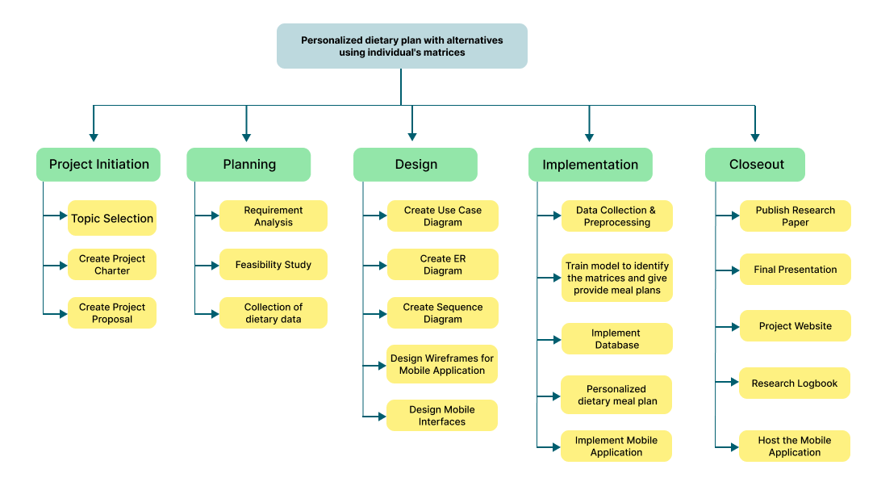
WORK BREAKDOWN STRUCTURE
IT21128936 | Rajakaruna R.H.M.S.A | R24-122

Slide 41
IT21114144 | Herath M.H.S.M
Specialization – Information Technology
IT21114144 | Herath M.H.S.M | R24-122

Slide 42
04
PERSONALIZED WORKOUT PLANS THROUGH ADVANCED BODY ANALYSIS AND CUSTOM RESPONSES​
COMPONENT
IT21114144 | Herath M.H.S.M | R24-122

Slide 43
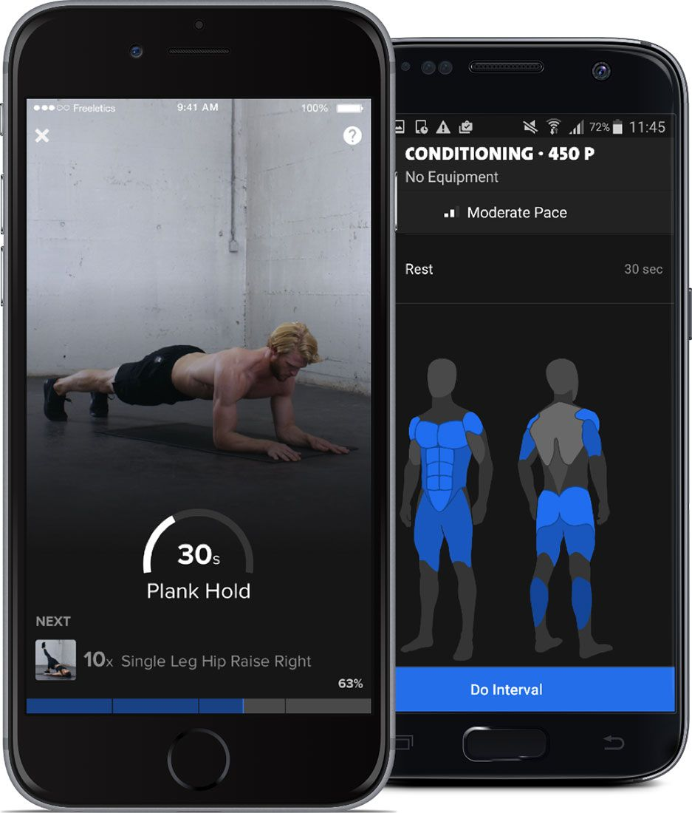
BACKGROUND
What is the purpose of implementing Emoji Feedback Function and Background Music Function ?
Focus mental & emotional well being
Satisfaction with workouts
Motivation and Enjoyment
IT21114144 | Herath M.H.S.M | R24-122

Slide 44
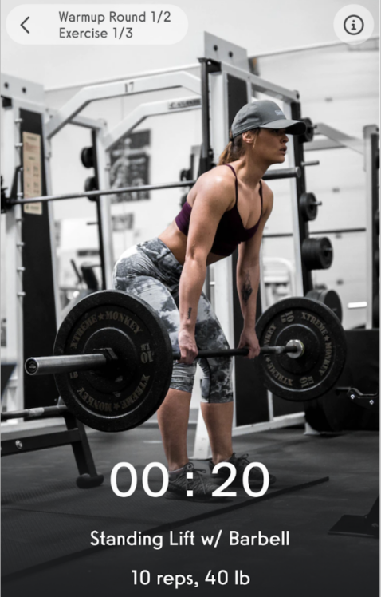
Why We Address?
It could be difficult to concentrate on health in the face of busy lifestyles and time constraints.
We are creating a system that uses machine learning and algorithms to create customized workouts depending on body analysis to solve this.
IT21114144 | Herath M.H.S.M | R24-122

Slide 45
LITERATURE REVIEW
‌[1] Ataman Z, Heybet ME, Sarısoy F, Yılmaz B, Günay M, Şenel Ö. “Personalized daily-weekly workout arrangement application ‘cardio fit’ ” J Comp Electr Electron Eng Sci. 2023;1(2):25-28., doi: https://doi.org/10.51271/JCEEES-0006
[2] Pulasinghe, K., Kelegama, T., Wadasinghe, D. V., Amarasinghe J.V.A, Kaluarachchi, P. L., & Ranaweera E.T.M. (2023). “Image processing and machine learning based nutrition and fitness journaling system”. International Research Journal of Innovations in Engineering and Technology, 7(10), 162-169. doi:https://doi.org/10.47001/IRJIET/2023.710021
[3] Manal Abdulaziz, Bodor Al-motairy, Mona Al-ghamdi, Norah Al-qahtani, “Building a Personalized Fitness Recommendation Application based on Sequential Information,” International Journal of Advanced Computer Science and Applications 12.1 (2021), researchgate.net
IT21114144 | Herath M.H.S.M | R24-122

Slide 46

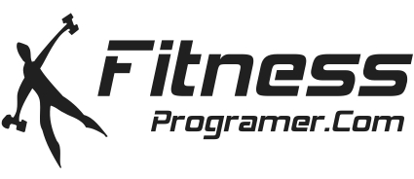

RESEARCH GAP
 |  | Research A [1] | Research B [2] | Research C [3] | Proposed solution
Personalized Workout Plans based on: | Body Analysis
 | Real-time data from wearable devices or user inputs
User Response Using Emojis for Satisfaction with Workouts
Background Music Integration for Each Workout
Mobile Application
IT21114144 | Herath M.H.S.M | R24-122

Slide 47
Specific Objective
Provide a customized workout planning tool that improves user experience before, during, and after workouts by utilizing body analysis data, emoji feedback, and customized background music.
Sub Objective
Data Gathering for Workout Plan Generation
Dataset Preprocessing for Machine Learning Model
Algorithm Implementation for Personalized Workout Recommendations
IT21114144 | Herath M.H.S.M | R24-122

Slide 48
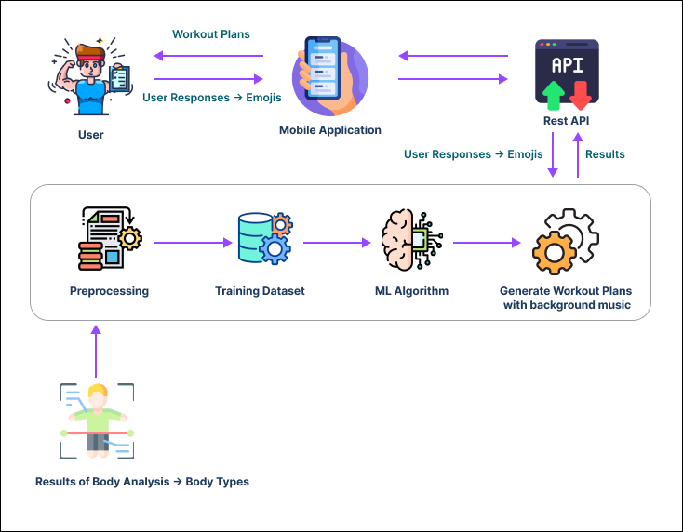
SYSTEM DIAGRAM
IT21114144 | Herath M.H.S.M | R24-122

Slide 49
TECHNOLOGIES
Flutter
python
Firebase
TensorFlow Lite
IT21114144 | Herath M.H.S.M | R24-122

Slide 50
REQUIREMENTS
Functional Requirements
Non-Functional
Requirements
Software
Requirements
Flutter, Dart, Python
User-generated workout plans based on body analysis data.
Compatible with diverse mobile devices and operating systems.
Firebase
User feedback integration using emojis
User-friendly interface that enables easy navigation and interaction.
Developing a playlist to enhance workout routine.
Personal
Requirements
Send workout reminders and notifications.
Online Resources
IT21114144 | Herath M.H.S.M | R24-122

Slide 51
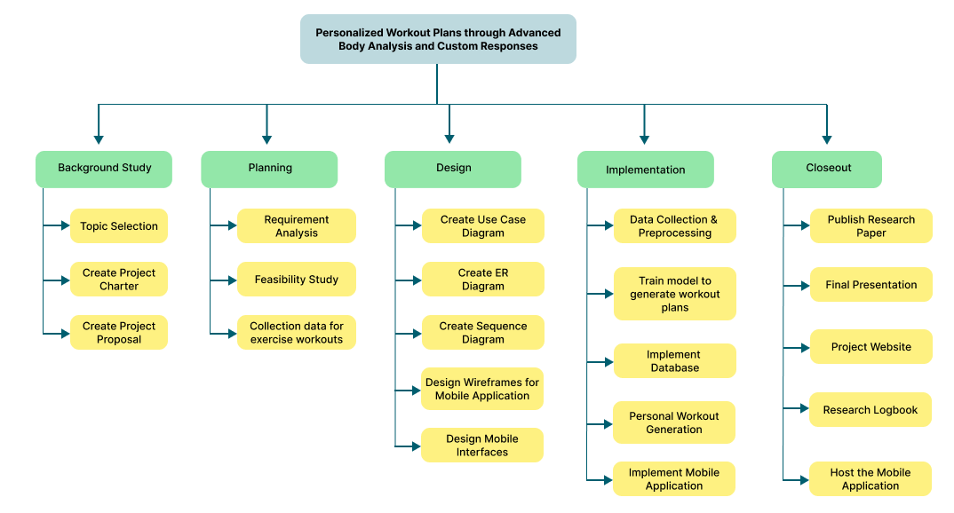
WORK BREAKDOWN STRUCTURE
IT21114144 | Herath M.H.S.M | R24-122

Slide 52
COMMERCIALIZATION​
MARKETPLACE
FREE VERSION
Make the app accessible to users of all ages without age limitations.
Easy to use for individuals without advanced technology knowledge.
Provide educational resources within the app to guide users on fitness and nutrition principles.
Identification of Body Types.
Real-time Exercise Feedback.
Dietary Recommendations.
Personalized Workout Plans.
TARGET AUDIENCE
PREMIUM VERSION
Fitness Enthusiasts
Health-conscious Individuals
Gym-goers
Personal Trainers
Advanced Body Analysis.
Advanced Real-time Exercise Feedback.
A wider variety of diet plans and workout options.

Slide 53

BUDGET
Component | Price
Travelling cost | RS. 20000
Developers' value of time | RS. 100,000
Database Price | RS. 7000
Play store publishing | RS. 9000
Marketing and Advertisements | RS. 14000
Total Value of the application | RS. 150,000

Slide 54
THANK YOU !

